Slide 1
Dynamic Memory Allocation
Vepuri Vinay Kumar

Slide 2
Contents
Types of memory allocation.
Need for dynamic memory allocation.
Ways of allocating dynamic memory.
Validating and freeing the memory allocated.
Types of errors.
Memory leak.

Slide 3
Types of memory allocation
Static memory allocation
  Storage space is given at built time.
  Allocation and freeing of memory is done implicitly at runtime.
Dynamic memory allocation
  Requests memory management subsystem of operating system, to allocate memory at runtime and which returns an address to the allocated memory space.
  Freeing of memory allocated is to be done explicitly.

Slide 4
Need for dynamic memory allocation
Can you add more elements into an array?
What about the unused memory?
int main()
{
int marks[4];
for(i = 0; i < 4; i++)
scanf(“%d”, &marks[i]);
}`
int main()
{
int marks[10];
for(i = 0; i < 10; i++)
scanf(“%d”, &marks[i]);
}

Slide 5
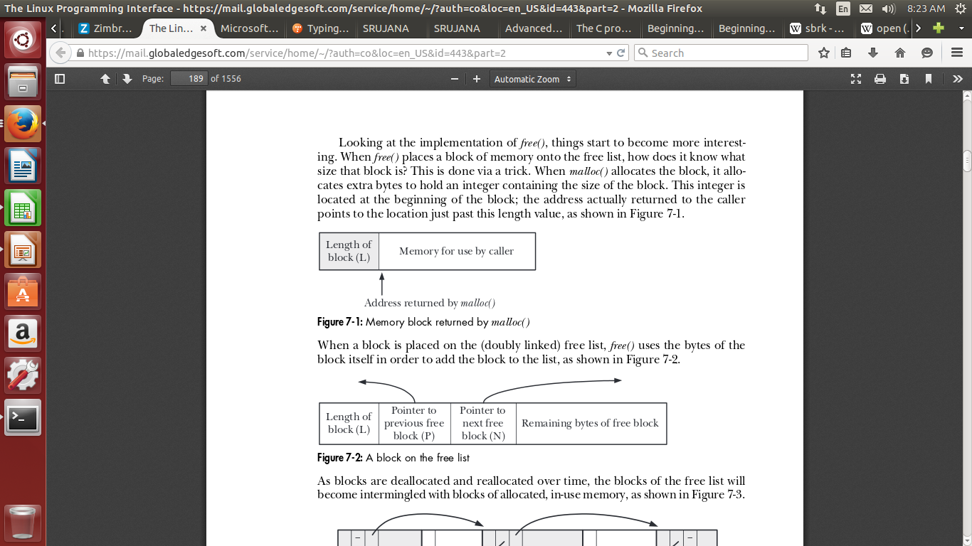
Ways of allocating dynamic memory
Using malloc()
  Syntax: void *malloc(size_t size);
  Ex: char *str = (char *) malloc ( sizeof(char) * SIZE);

Slide 6
Ways of allocating dynamic memory(contd...)
Using realloc()
  Syntax: void *realloc(char *ptr, size_t size);
  Ex: str = realloc(str, sizeof(char) * SIZE);
Using calloc()
  Syntax: void *calloc(size_t nmemb, size_t size);
  Ex: char *name = (char *)calloc(NUM_ELEMENTS, sizeof(char));

Slide 7
Validation and free
Validation:
  main(){
  int *marks = NULL;
  marks = malloc(sizeof(int));
  *marks = 35;
  }
  main(){
  int *marks = NULL;
  marks = malloc(sizeof(int));
  if(marks == NULL){
    /*error handling*/
  }
  }

Slide 8
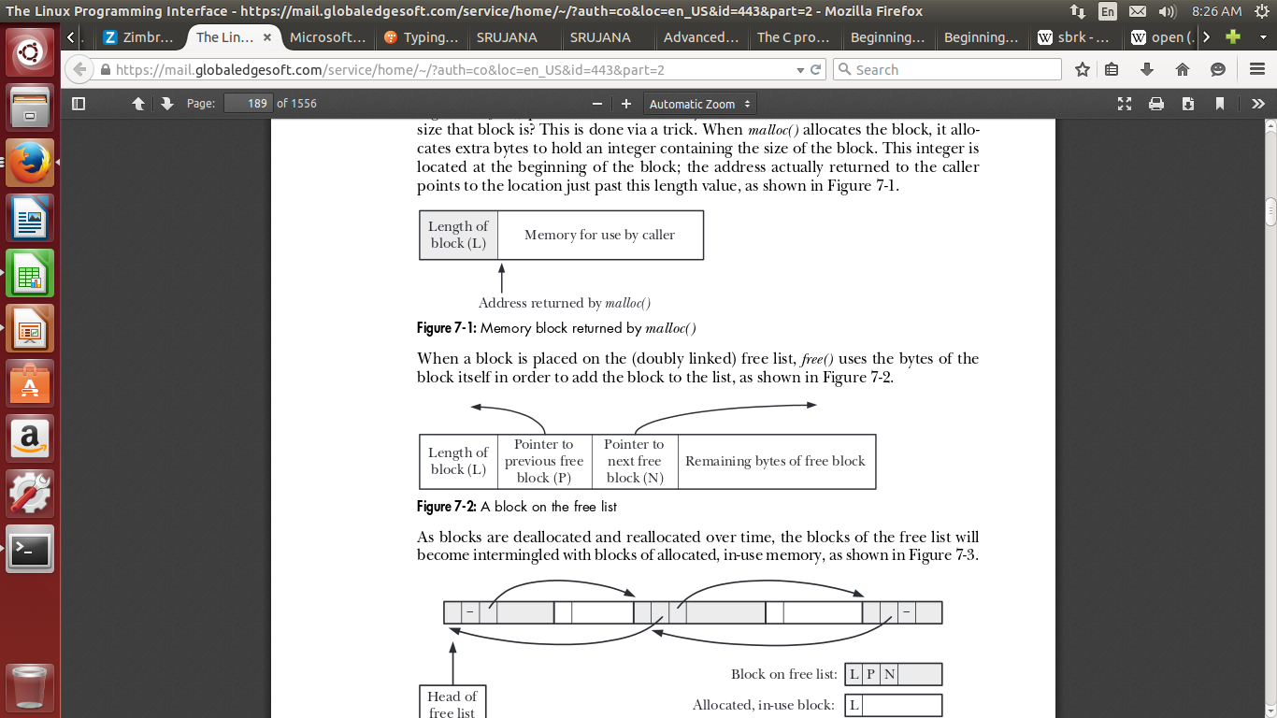
Validation and free(contd...)
Freeing of memory allocated.
  Syntax: void free(void *ptr);

Slide 9
Types of errors in dynamic memory allocation
Forget to check return value of malloc.
Referring to dangling pointer.
Double free.

Slide 10
Memory leak
What happens when we allocate space for a variable and lost the pointer to it, without freeing it?
This leads to memory leak.
This may exhaust the memory space.

Slide 11
Summary
Types of memory allocation i.e., static and dynamic.
Need for dynamic memory allocation.
Ways of dynamic memory allocating i.e., malloc(), realloc(), calloc().
Validation and freeing.
Errors that may be encountered.
Memory leak.

Slide 12
Any queries?

